Slide 1
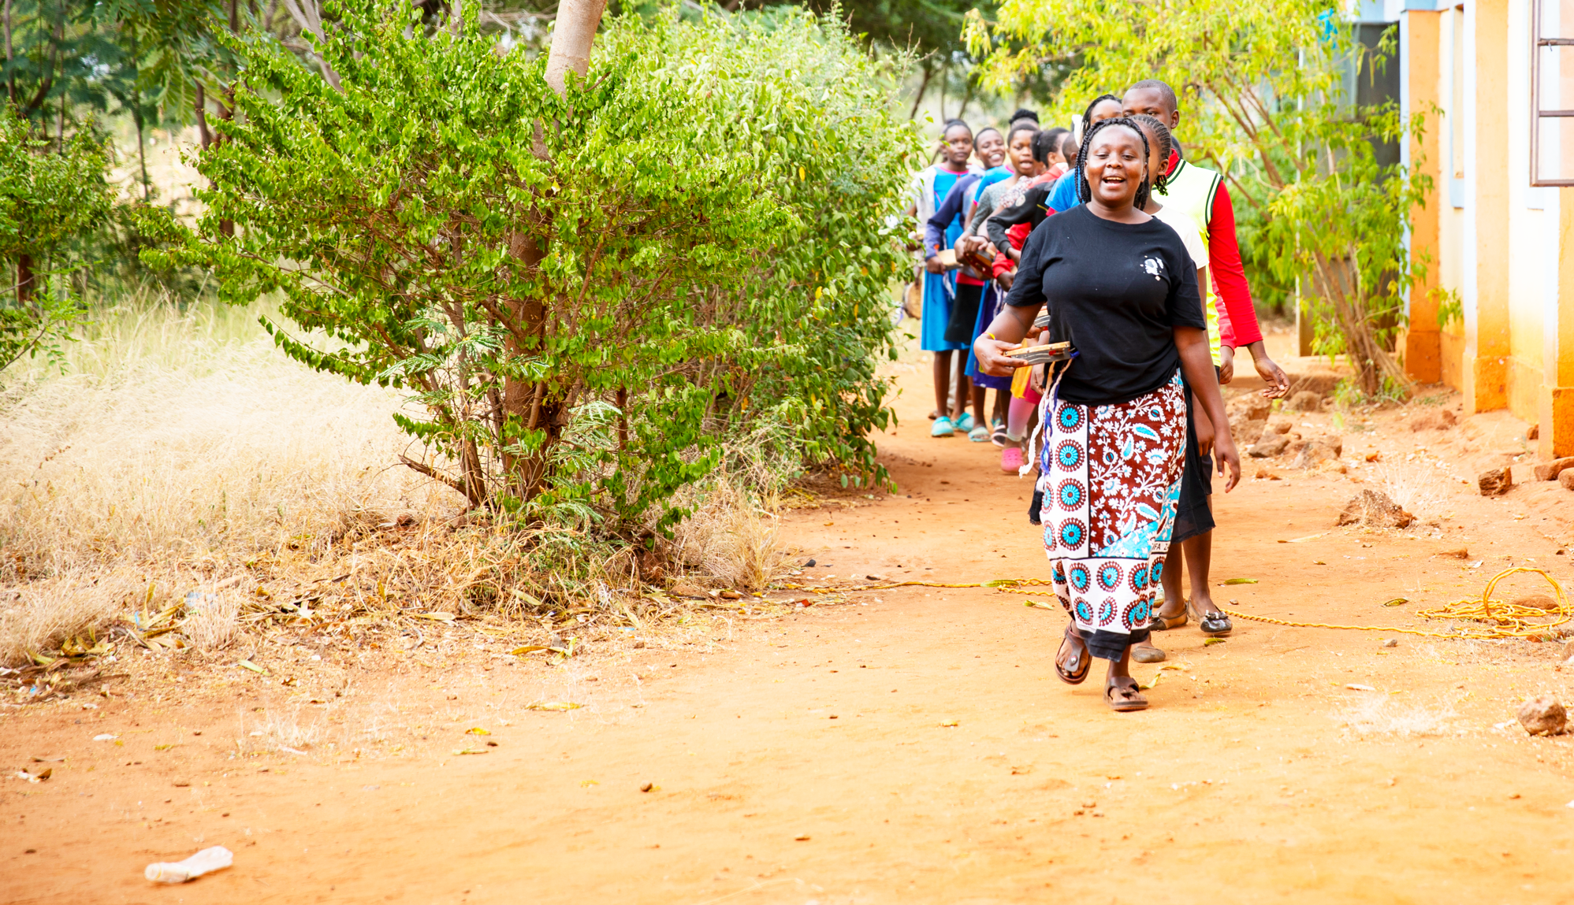
Going Beyond Church Walls
Tearfund Sunday 2023

Slide 2
Who is My Neighbor?

Slide 3
We think of…
Those in our neighborhood
Generally speaking we have a lot in common

Slide 4
Our Neighbor's in the Global South
Extreme Poverty
Climate Challenges
War, conflict
Difficult decisions around food

Slide 5
Luke 10:25-37
A familiar parable

Slide 6
Luke 10:25-37
A desolate place
Man beaten and robbed
Ignored by the respected in society
Cared for by the Good Samaritan in an extravagant way
An unexpected story

Slide 7
A Challenge about Neighborliness
Breaking down the walls in both our personal and church world

Slide 8
“It is our willingness to act with empathy and kindness that defines our character.”

Slide 9
Kenya and Church & Community Transformation
Fadhilli Trust
Holistic Transformation
Bringing down walls

Slide 10
VIDEO

Slide 11
Mercy’s Story
23 years old – Makindu, Kenya
Dreams of being a teacher one day
Raised in a humble home
Father died when she was young
Mercy’s mother worked relentlessly to provide for Mercy and her siblings and adopted cousins
Mother develops health issues and passed away in 2021
Leaving Mercy to take care of her family
Notes:
Mercy’s life is a powerful testament to God’s unyielding love and grace. After losing her father at a young age, Mercy’s mother worked tirelessly to provide for her and her siblings. Mercy poured herself into her studies and excelled academically as she aspired to become a teacher and provide her family with a better life. However, tragedy struck when her mother became sick and passed away, leaving her as the sole provider for her many younger siblings and cousins. In the face of overwhelming challenges, one local church stepped in— empowered and equipped by Church-Based Transformation training by Tearfund. The congregation rallied around Mercy, providing her with food and assistance. With the church’s help, Mercy restarted her mother’s grocery business to provide for her family. Despite overwhelming odds, Mercy still has hope for the future, praying for guidance and strength as she hopes to be a teacher one day.

Slide 12
The Church Responds
Trained in Tearfund’s Church-based Community Transformation program
Saw Mercy and her struggle
Supported her with food, training, prayer, and encouragement

Slide 13
Break down Barriers that Separate

Slide 14
Join us an Outpour Partner!
A devoted group of monthly donors passionate about helping end the cycle of poverty through God’s love
Your monthly contribution provides:
The tools and training for one family to escape poverty (each year)
Church-based community transformation to help churches transform their communities
Our prayer is that all people are healed and restored – physically, emotionally, socially and spiritually!

Slide 15
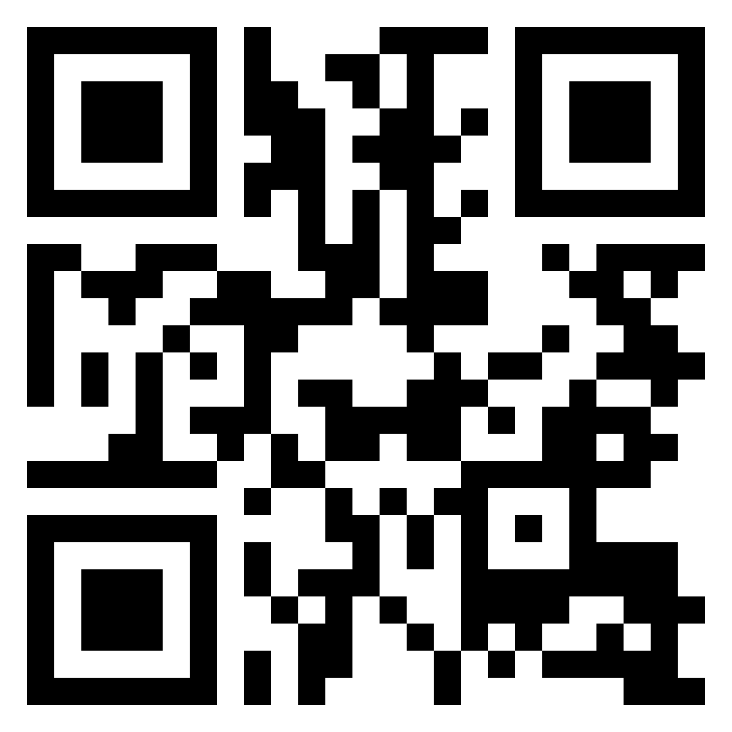
tearfund.ca/outpour

